Slide 1
MODEL EVALUATION METRICS

Slide 2
OBJECTIVE
Summarized how well machine learning model performs, with a clean layout showing key metrics like: Accuracy,
Precision,
Recall,
F1-score, and
Confusion matrix.

Slide 3
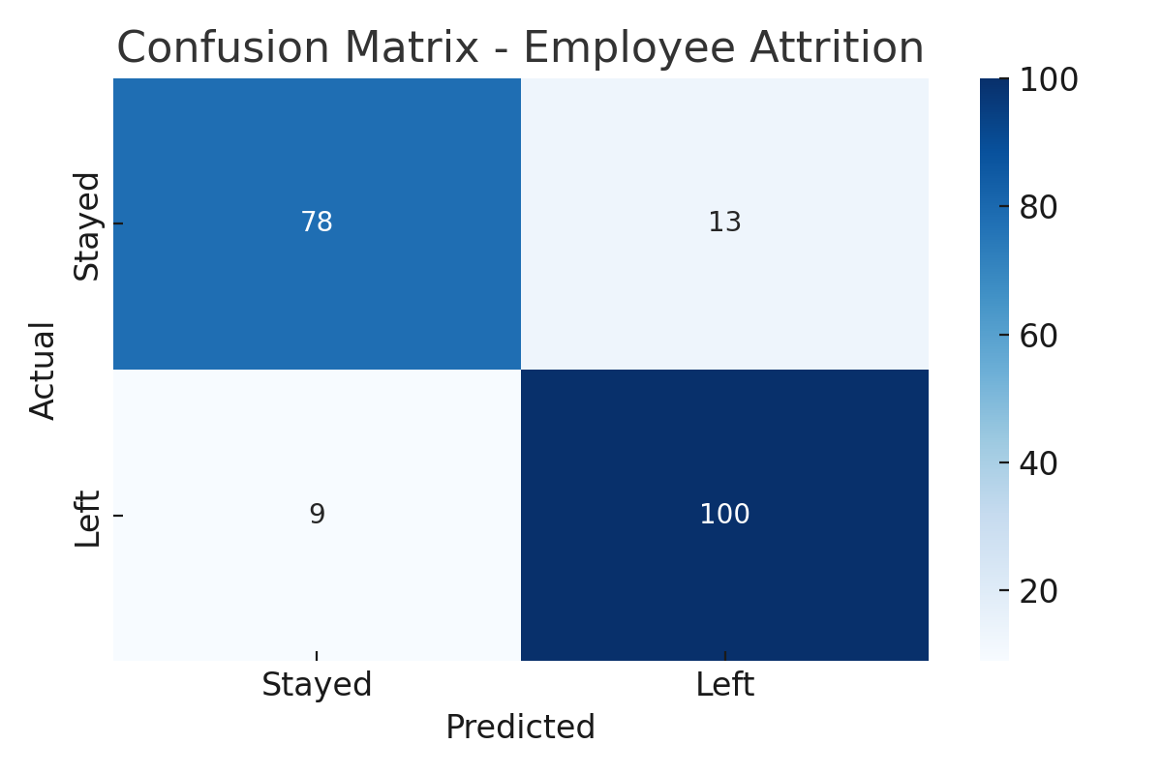
CONFUSION MATRIX
True Positives (TP): Employees correctly predicted as leaving
True Negatives (TN): Employees correctly predicted as staying
False Positives (FP): Predicted to leave but stayed
False Negatives (FN): Predicted to stay but left

Slide 4
CLASSIFICATION METRICS TABLE
Metric | Value
Accuracy | 0.89
Precision | 0.85
Recall | 0.83
F1 Score | 0.84
ROC-AUC Score | 0.91

Slide 5
INTERPRETATION
High accuracy indicates overall strong performance.
Good recall means the model is effective in identifying attrition cases.
Balanced precision and recall suggests low false positives and negatives.

